Slide 1

Food & Nutrition Trust Schools Competition 2026
TrustEd and beyond!

Slide 2

Theme
Teacakes should be presented in the theme of ‘Around the world in a bite’

Slide 3
Submissions
You will need:
A clear, high-quality photograph
A description of your entry including details of how the entry meets the challenge criteria
Your school name
Your age or year group

Slide 4
Tips
Use a range of finishing techniques such as garnishing and decoration e.g. piping.
Create a structure/layers
Contrast colours and textures on the plate
Add colour with fruit/leaves/zest
Create patterns and shapes
Stick to the brief – ‘Around the world in a bite’.

Slide 5
How will it work?
Photo entries to be emailed to Jennifer.butler2@csschool.co.uk by Friday 22nd May.
Photo entries will be judged by a panel comprising of Church Stretton school staff.
The winners from each year will go forward to the final, where finalists from trust schools will come to CSS to recreate their designs on Thursday 4th June.
These will then be judged by a panel comprising of representatives from the Trust.
There will be 5 age group Champions (1 each from EYFS/KS1/2/3/4).
We will also choose an overall winner for outstanding work that was not a prize winner.
Winning entries may be submitted to a national competition and, if selected, will be showcased at the Tunnock’s factory in Glasgow and featured in a printed book of winning designs.

Slide 6
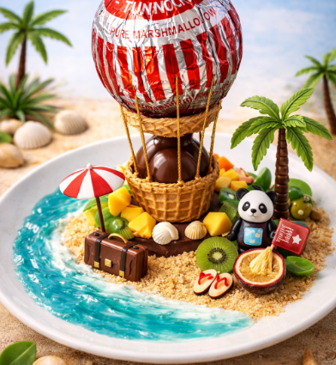
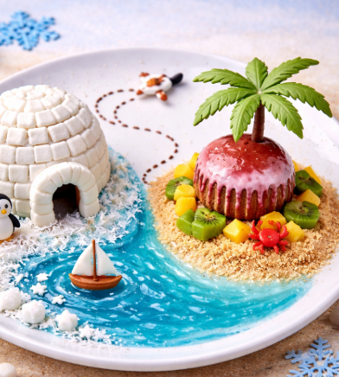
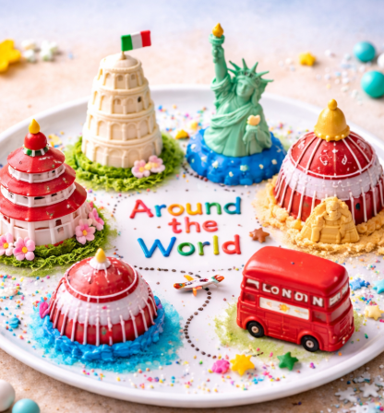
Next steps
For more details, to register your interest and get tips/techniques on chocolate work, sugar work, chocolate soil, fruit gels & biscuit tuilles, email Mrs Butler Jennifer.butler2@csschool.co.uk

